Slide 2
WHAT IS WELLNESS
Wellness is defined as an ongoing process to enhance the many dimensions of well-being that enable people to reach and maintain their personal potential, and contribute to their communities.
WELLNESS IS A UNIVERSAL ISSUE
4 PILLARS OF WELLNESS
Healthy Eating Physical Activity Tobacco Free Living Mental Fitness & Resilience
WHAT IS A WELLNESS NETWORK
Wellness networks are a formal or informal group of people who come together from various backgrounds within a community or region to address an area of concern around wellness. They may be working toward improved healthy eating, increased physical activity, or another wellness goal. They strive to improve wellness for all those in their communities or regions, including vulnerable populations.

Slide 3
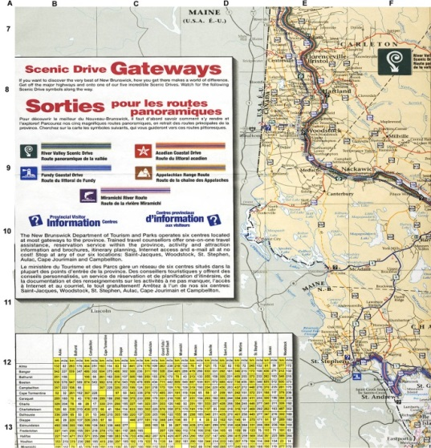
Western Valley
More than 39 communities – 3 towns, 8 incorporated villages & 27 local service districts (LSD)
Covers more than 71,377 km
Population 27,019
Anglophone

Slide 4
Our process …
Wellness Seminar Consultation health care & wellness stakeholders
June 2010
Creation of Wellness Network
HEPAC Call for Interest
June 2010
Wellness Profiles
5 COMMUNITY Presentations
February 2011
Partnership building Community activities
June 2011
HEPAC Wellness Consultant
Partnerships & Community Engagement
Sept. & December 2010
Defined who we are
Vision / mission / objectives
December 2011
Wellness Forum
Evaluation & Feedback
March 2012
Wellness Network
Strategic Planning
June 2012
LAUNCH
In motion
Sept. 2010
Notes:
Key steps as a best practice to be utilized in all other wellness regions

Slide 5
Wellness Consultant
Wellness Culture & Sport
June 2012
Promotions of Resources
Creation of Formal Structure
Increase ROLE of Network
FORMAL GRANT PROGRAM & NETWORK BUDGET
April 2013
Partnership building Community activities
April 2013 – April 2014
April 2014 – 2015
Wellness Network Funding for Year Long Initiatives
Strategic Planning
Network Goals
Facilitated in January 2013

Slide 6
Western Valley Wellness Network Vision:
Healthy, active, inclusive communities
Western Valley Wellness Network Mission:
Promote wellness for all people in the Western Valley region by facilitating community based opportunities and initiatives
Goals:
Ensure WVWN planning is research based
Build capacity through community and partnership development
Facilitate opportunities and initiatives that engage communities and individuals
Actively communicate and build awareness around wellness

Slide 7
Members of Western Valley Wellness Network January 2015:
Celeste Roberts – MACC – Co-Chair of Network
Bonnie Stokes – Registered Dietitian – Treasurer
Tanya Hawkes & Chris Stacey – WVRA – Secretary & Signing Officer
Valerie Carmichael – Community School Coordinator – ASD-W
Roberta Knox & Julie McConaghey – Healthy Learners in Schools – ASD-W
Mary Lawlor O’Leary – CVCIN Community Inclusion Coordinator
Brent Cummings – Simply For Life
Kelly McLean Haley – Wellness Tree Services
Rosie Mosse & Emily Shapiro – Falls Brook Center
Chelsey Phillips – CMHA
Gail Farnsworth – My Gym – Nackawic & Area Wellness Committee
Danny Braun – Tobique Health Center – Community Coordinator
Marta Dingle for Colleen MacDonald – Public Health - Dietitian
Sue McLaughlin – Valley Family Resource Center
Victoria Hutt - McCain Art Gallery
Allison Sappier – Tobique First Nations
Janet Gee – Go Ahead Senior’s Coordinator
Rosalyn Drake – Riverside Court
Amanda Taylor – Talk With Me Program – ASD-W
Kathy Sherwood Orser – Wellness Branch – Wellness Consultant
Theresa Blackburn – Wellness Ambassador

Slide 8
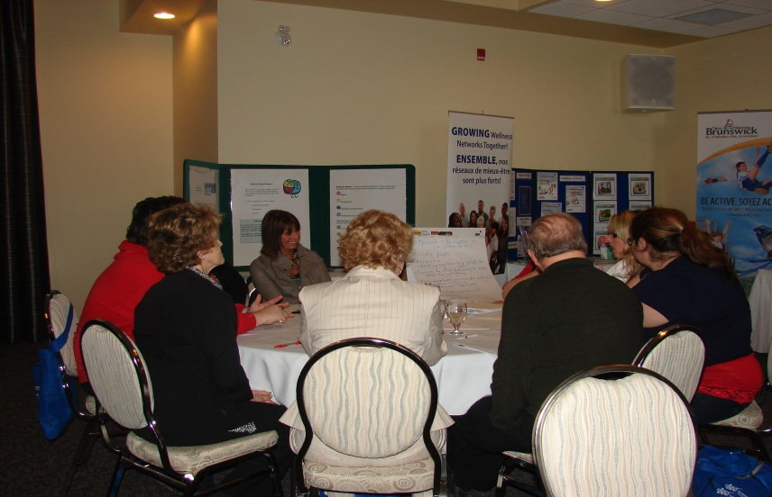
The Development of Western Valley Wellness Network
Public Dialogue – Wellness Forum
Wellness Forum, March 2012
Notes:
Short video that shares the initiatives implemented by the Acadian Peninsula Wellness Network

Slide 9
Stakeholder recommendations for future action: 2012
Communities
ENHANCING WELLNESS AWARENESS
• Strengthen communication between providers, facilities and communities (e.g., newsletters, social media, centralized community bulletin boards)
• Increase health and wellness education
• Increase awareness of natural resources in Western Valley
ENHANCING WELLNESS PARTICIPATION
• Increase access to programs and facilities
• Maximize community centres and ensure equitable access
ENHANCING WELLNESS ENVIRONMENTS
• Provide incentives for wellness (e.g., tax incentive for
volunteer hours, exempt taxes for sports and recreation)
• Build communities with active transportation environments
• Engage Town Councils in wellness mandate

Slide 10
Stakeholder recommendations for future action: 2012
Homes
ENHANCING WELLNESS AWARENESS
• Increase access to wellness information (e.g., flyers, newsletters, websites, learning kitchens
ENHANCING WELLNESS PARTICIPATION
• Provide wellness outreach to communities (e.g., book mobile model, community kitchens, community gardens, cooperative gardens)
• Facilitate healthy eating, especially for lower income families (e.g., organize fresh produce distribution system, use garden surplus approach, support learning kitchens, provide coupons
for healthy foods)
ENHANCING WELLNESS ENVIRONMENTS
• Address co mmu nit y based transportation ( e . g . dia l-a-ride Rotary van project, public transportation)
• Increase engagement o f muni ci pal officials (e.g., educate official on community needs, organize open forum and share dialogue with community)

Slide 11
Stakeholder recommendations for future action: 2012
Schools
ENHANCING WELLNESS AWARENESS
• Increase emphasis on 4 pillars and lifestyle factors (e.g., make courses a requirement for health, raise awareness regarding mental health, tailor curriculum to community, identify what youth value now, make it fun)
• Foster self esteem & healthy relationships (e.g., have ‘go to’ person at school, “Wave” program/Sanctuary House, girls events)
• Address access and use of illegal substances (e.g., educate early, invite guest speakers, Crime Stoppers, community members)
ENHANCING WELLNESS PARTICIPATION
• Coordinate activities for middle school students at noon (e.g., have leadership class coordinate intramurals, access wellness grants for equipment and resources, engage community partners like businesses, Go NB grants)
ENHANCING WELLNESS ENVIRONMENTS
• Enhance physical activity in schools ( e.g. mandate physical activity in all schools, every day)
• Respect different learning paces (e.g., not all kids learn at same pace in same way, respect differences, include variety of approaches )

Slide 12
Stakeholder recommendations for future action: 2012
Workplaces
WELLNESS AWARENESS
• Increase wellness awareness in workplaces (e.g., establish business distribution list including Chambers, present to Chambers, use community website for promotions, conduct lunch & learns, coordinate workplace wellness article club similar to book clubs,
Form wellness committees at workplaces, present to senior management on benefits of workplace wellness)
• Increase wellness awareness among employees (e.g., distribute key resources of healthy restaurants, services, programs, speakers)
ENHANCING WELLNESS PARTICIPATION
• Use incentives to support employee participation (e.g., gym membership, exercise class passes, sport registration subsidy, massage therapy)
• Encourage physical activity (e.g., longer break s, workplace challenges, incentives, employee support systems, desk activities)
ENHANCING WELLNESS ENVIRONMENTS
• Encourage healthy eating policies in meetings , cafeterias

Slide 13
The Development of Western Valley Wellness Network
With current Government & Priorities/Action Plan
Onus to ALIGN our Strategic Plan to that of Wellness Branch
ACTIVITIES | Partnerships and Collaboration | Asset Based Development | Promotion | Leadership, Policy and Legislation | Evidence Informed Practice

Slide 14
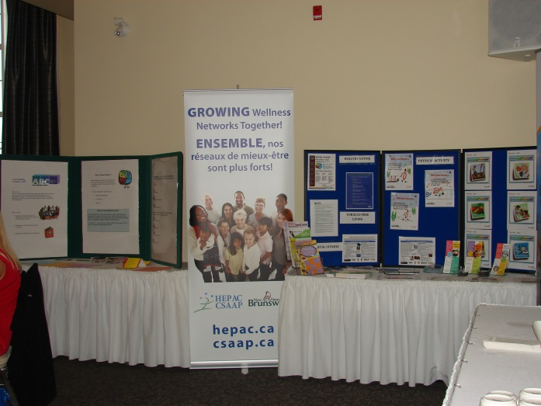
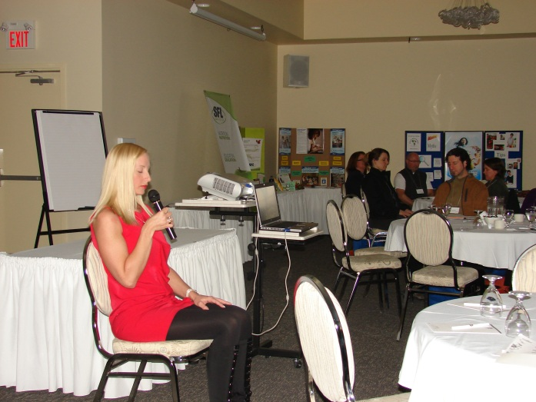
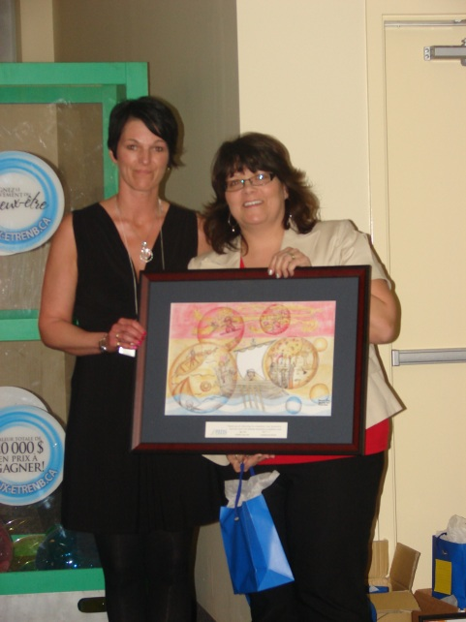
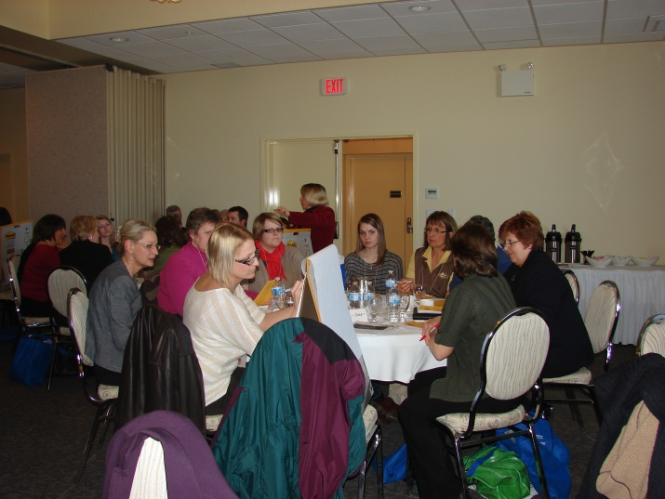
Western Valley Wellness
Network

Slide 15
Community Capacity Building (NOW ASSET BASED DEVELOPMENT)
Community Planning Workbook
Community Capacity Building (Partnerships)
Community Engagement (Partnerships)
Community Mobilization (ABCD)
Promotions (Communications)
Leadership & Research & Evaluation
Sustainability

Slide 16
Step 1: Define the Issue – NB HEALTH COUNCIL
Wellness is an ISSUE in Western Valley BECAUSE?
Therefore, the target population(s) would be…
1.
2.
3.
4.
5.
Step 2: Define the Membership and Commit to Collaborate
“Partnerships can save time and money and bring energy and influence that no single organization can
bring to a problem such as the promotion of physical activity.” (Howze, 1999)
􀃏 Power in numbers and resources
􀃏 Identifies synergies and collaborations
􀃏 Talent pool well beyond the resources of a single organization
􀃏 Contributes to sustainability
􀃏 Non-traditional partnerships offer a broad perspective on the health of our community
􀃏 Address important health issues with a shared responsibility

Slide 17
Step 3: Create a Common Vision - Never doubt that a small group of thoughtful, committed people can change the world. Indeed it is the
only thing that ever has.” – Margaret Mead
􀃏 Vision is a picture of where you want to go.
􀃏 When you know what you are working toward, it is easier to know how to get there
Step 4: Develop an Action Plan
􀃏 A MISSION is how you will get there.
􀃏 Clearly describe your initiative, what you will do to achieve your vision, and why you are doing it.
developing operating principles
Broad statements of intent
􀃏 Puts your mission statement into practice
􀃏 Closes the gap between where you are now (current situation) and your vision (where you want to be)
􀃏 Your guiding principles…”We believe that…”
Step 5: Establishing Roles & Responsibilities
Partner Role Gives Gets

Slide 18
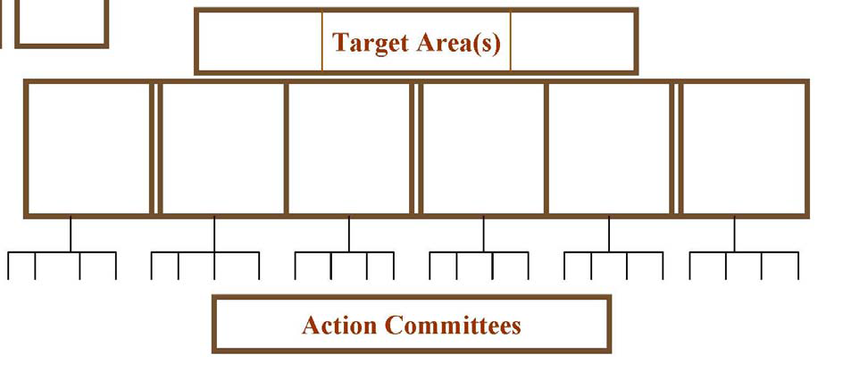
Step 6: Establish an Administrative Structure
Why develop a formal administrative structure?
• Ensures communication
• Generates political will
• Establishes a framework for how people will work

Slide 19
Step 7: Establish a System for Communicating (Promotions & Marketing
A communications plan is a written strategy for how to get the word out about your strategy and to mobilize people to be more well.
developing key messages
internal communication
external communication
Branding your Image
Step 9: Develop an Evaluation Strategy
why evaluate?
developing your strategy

