Slide 1
Regional Addictions and Mental Health Prevention Coordinators
Tanya Wilson

Slide 2
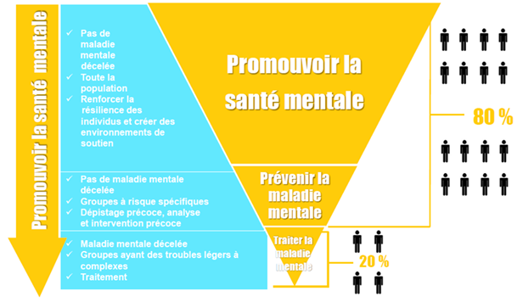

Slide 3
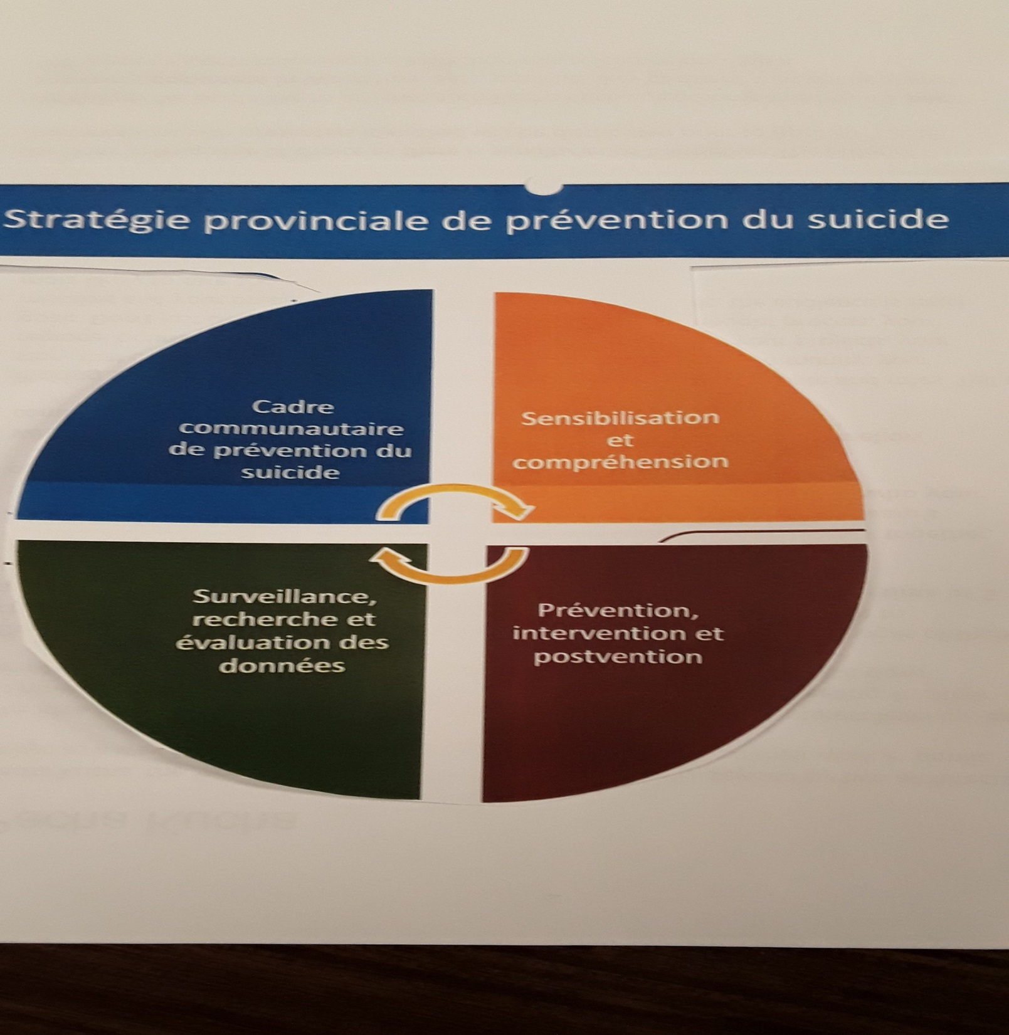

Slide 4
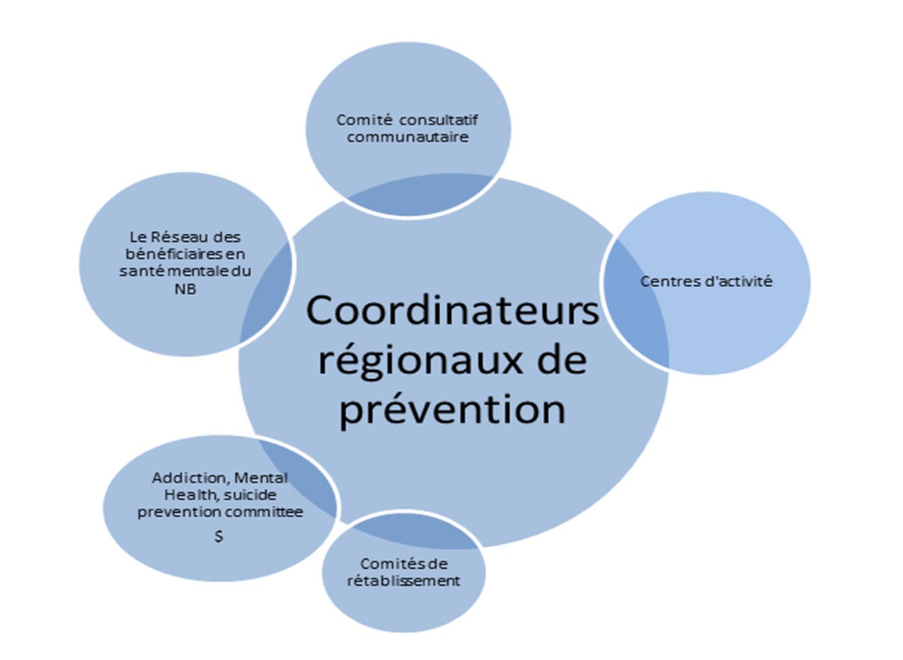


Société de Schizophrénie
Comité du Mieux Etre
Communautés de Premières Nations
ACSM

Slide 5
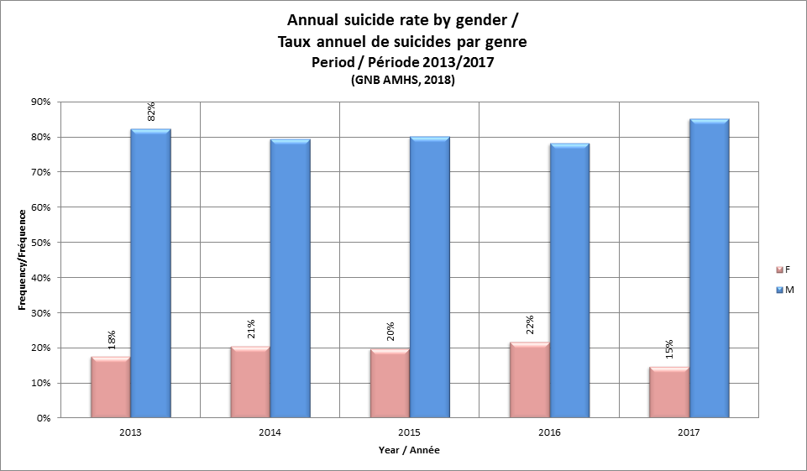

Slide 6


Slide 7


Community Health Needs Assessments (CHNA)
Karine Regnier, Vitalité’s Regional Project Coordinator, CHNA
Erin Kelly , Horizon’s Research Lead, CHNA Team
Gabrielle Levesque, Horizon’s Regional Facilitator, CHNA Team
Mila MacLeod, Horizon’s Project Coordinator, CHNA Team

Slide 8



Slide 9



Slide 10




Slide 11
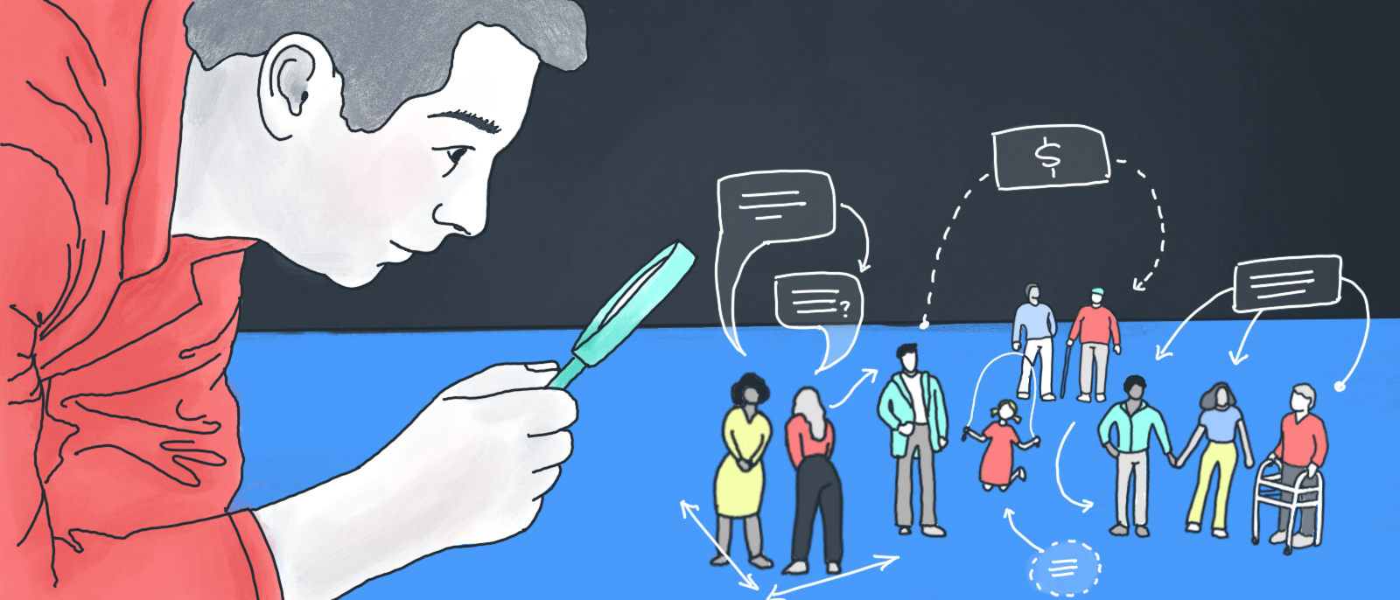

Slide 12
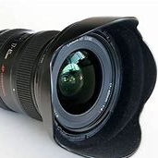


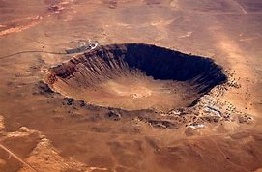

Slide 13

Horizon’s ‘Boots on the Ground’
Scott Crawford - Regional Manager
Community Development

Slide 14
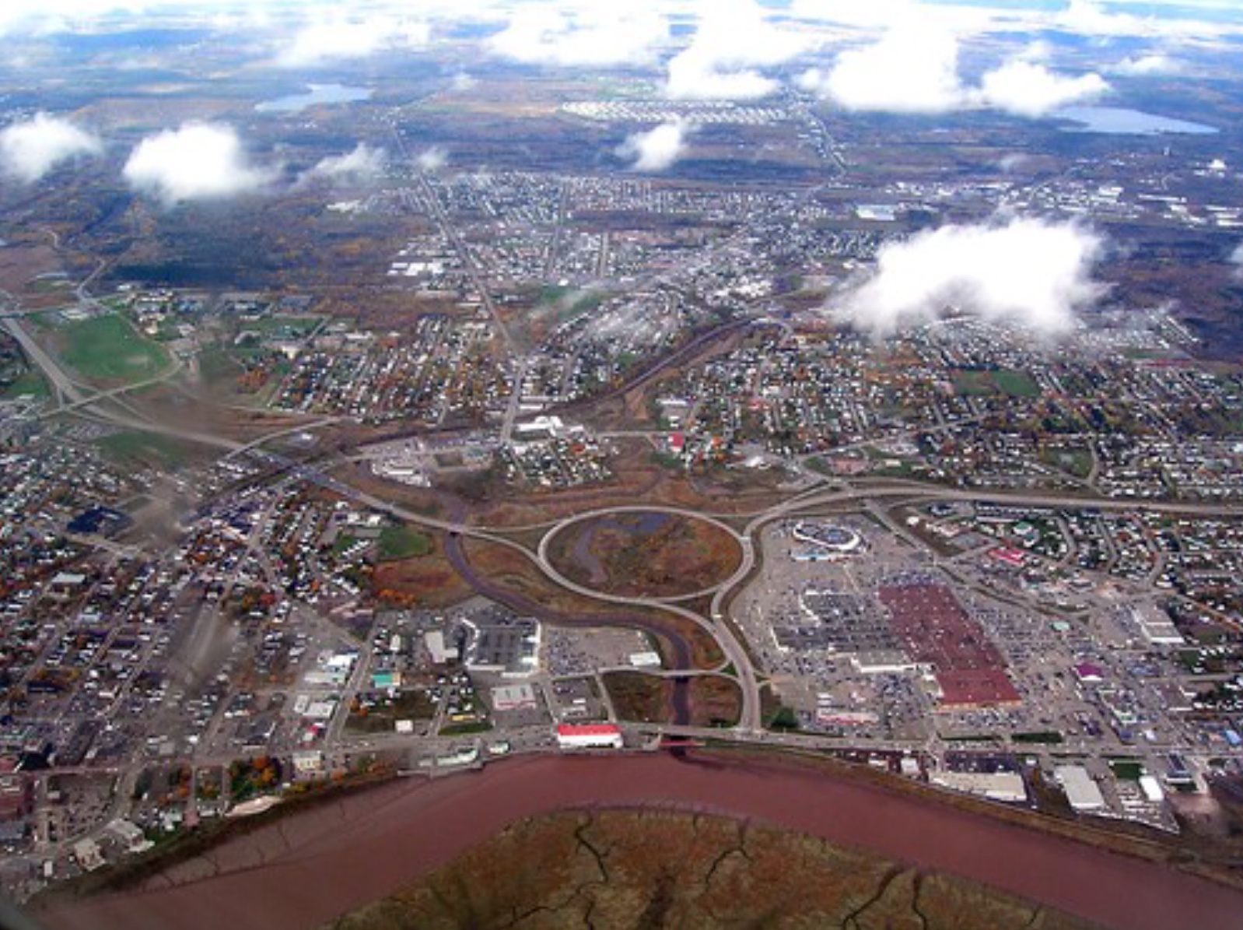

Slide 15
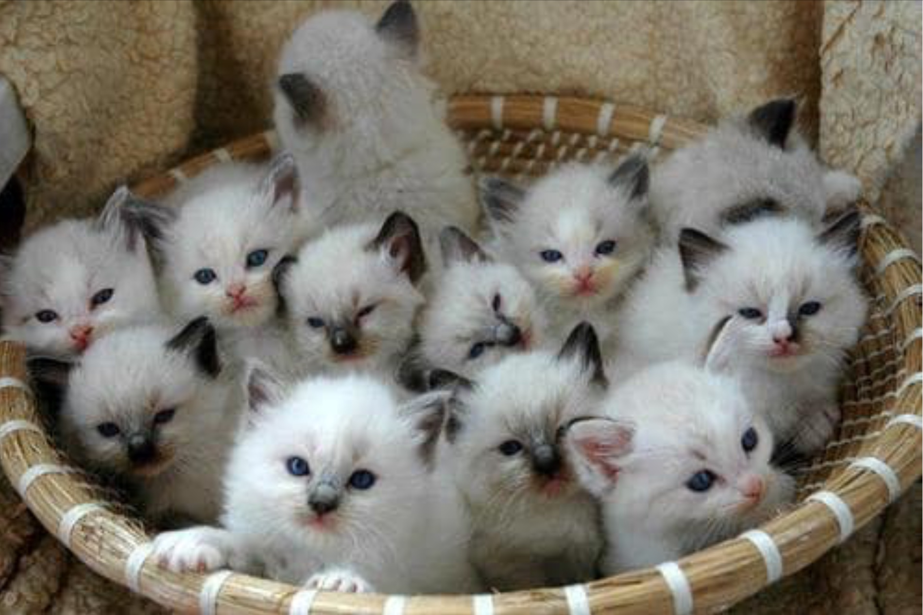

Slide 16
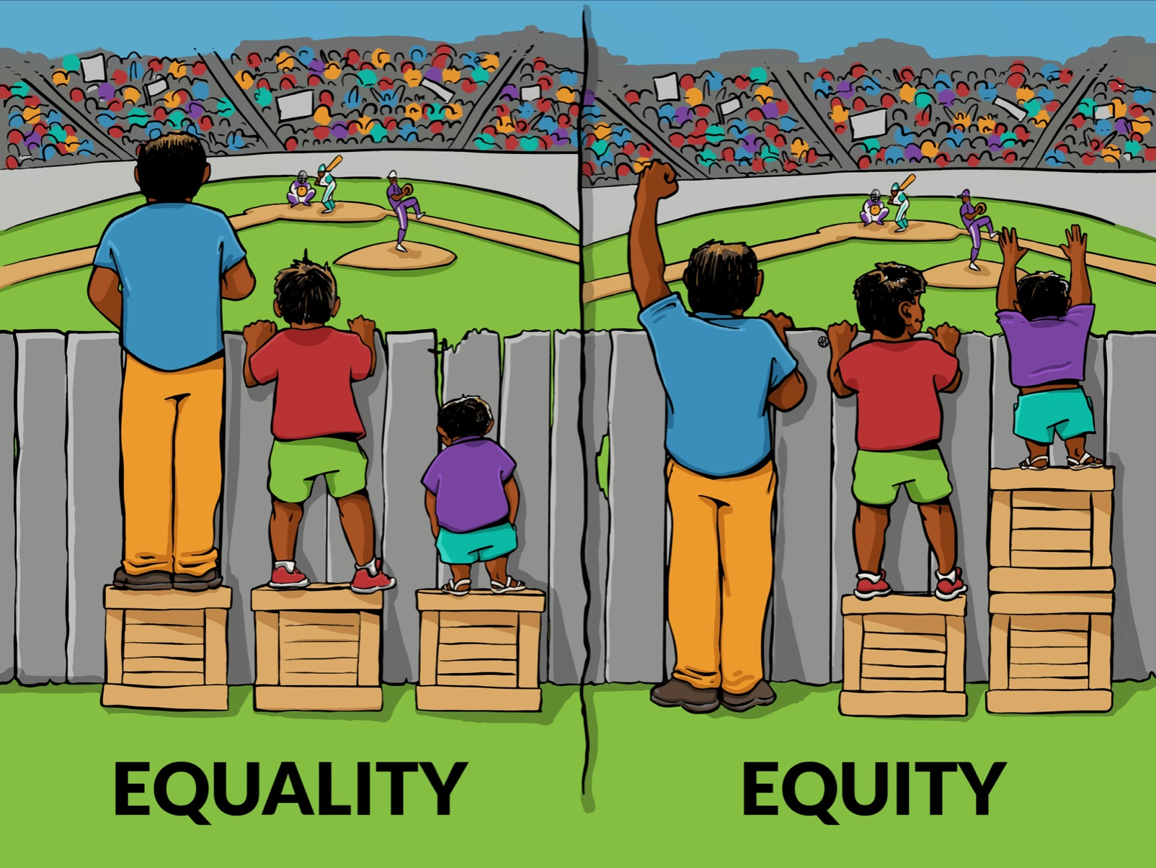

Slide 17
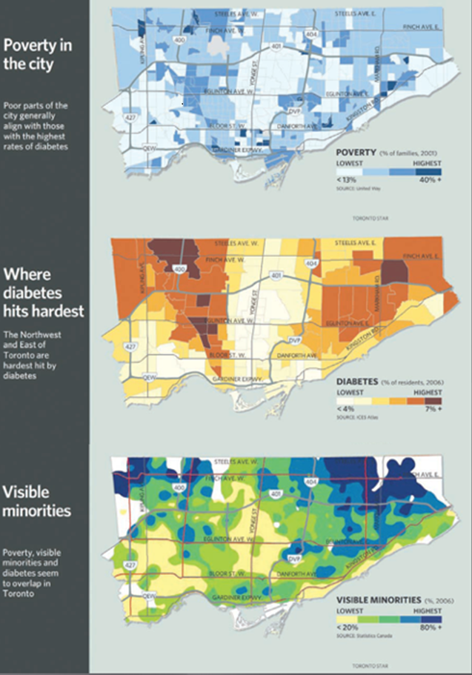

Slide 18


Slide 19
Primary Care Access Coordinators in Vitalité

Slide 20


Slide 21


Slide 22


Slide 23
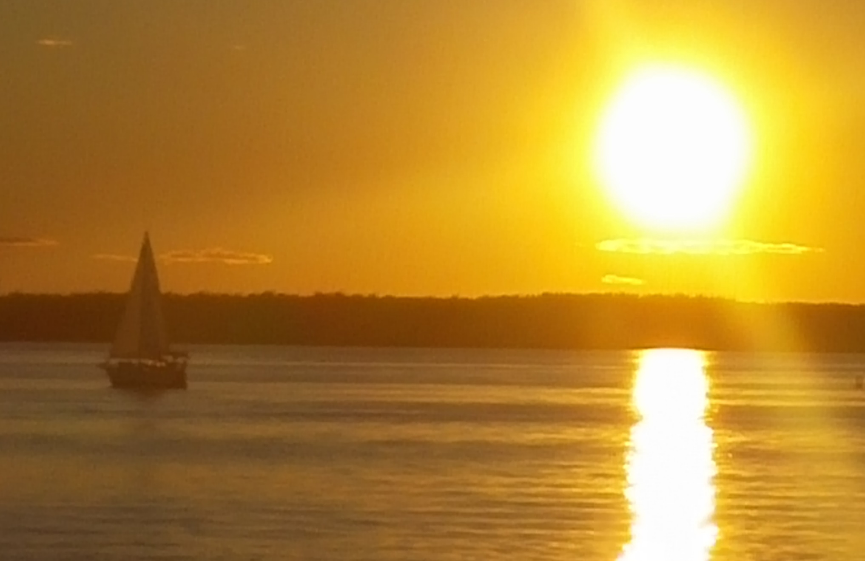

Slide 24
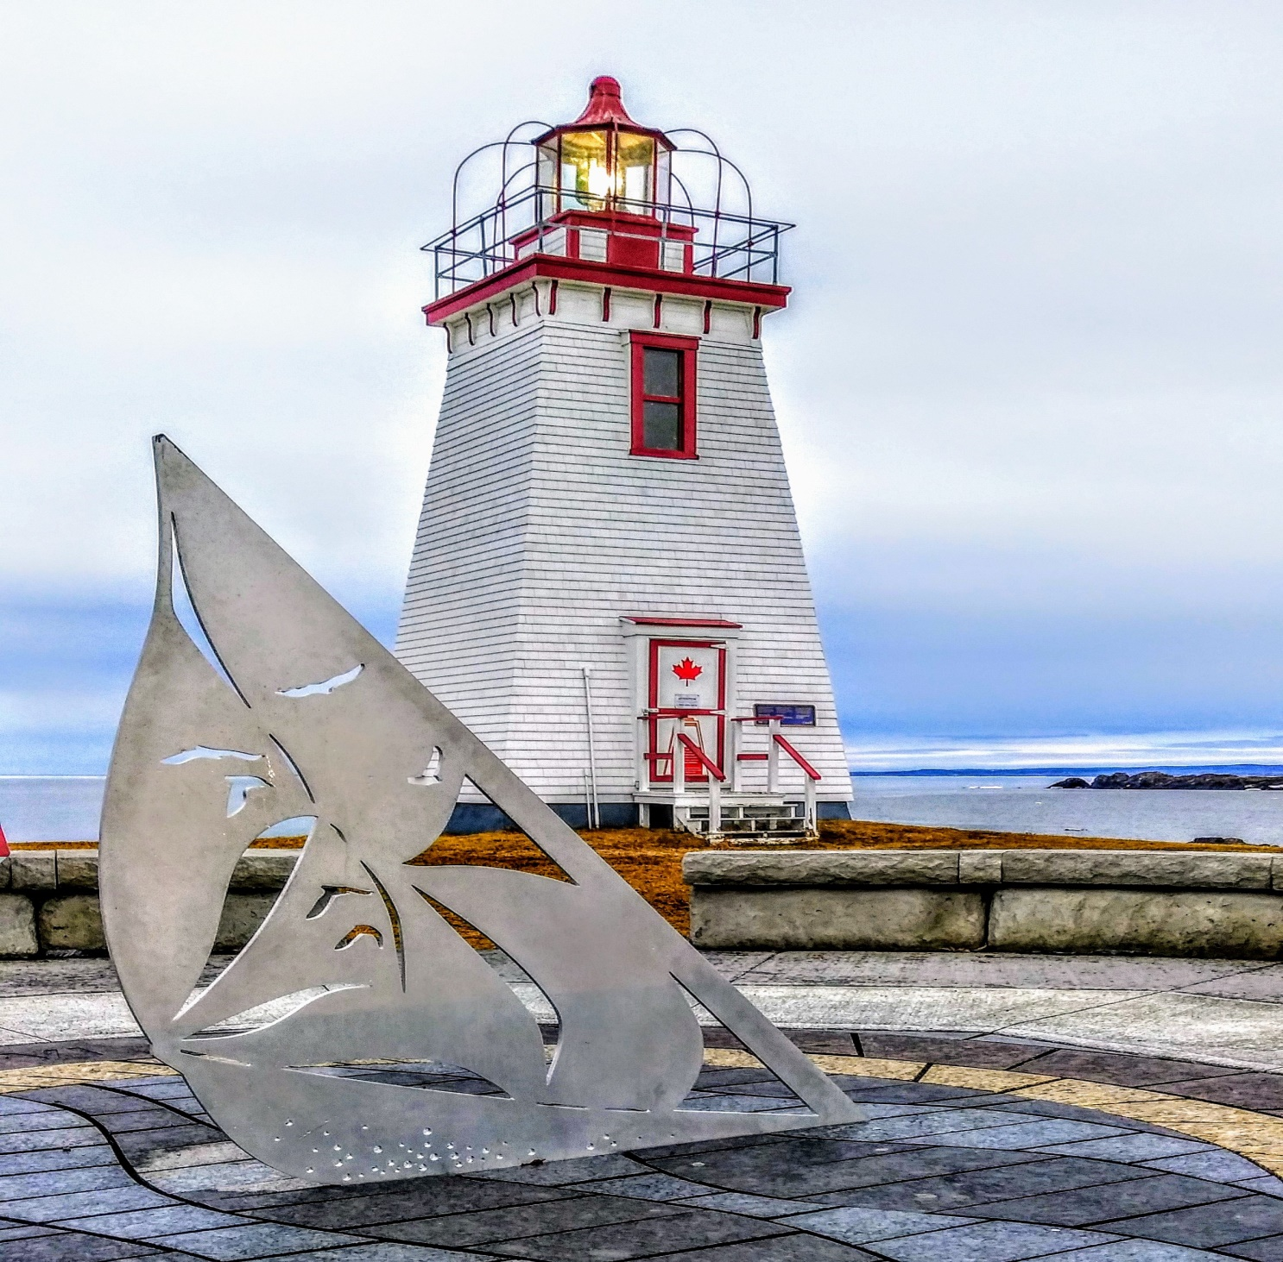

Slide 25
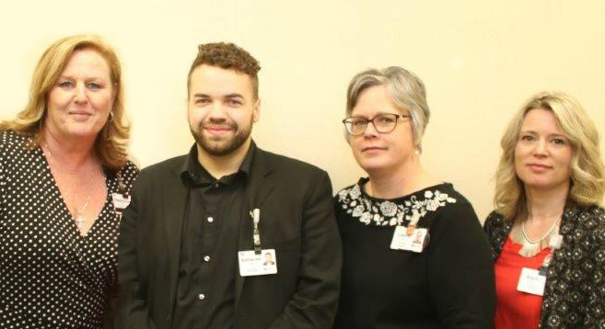
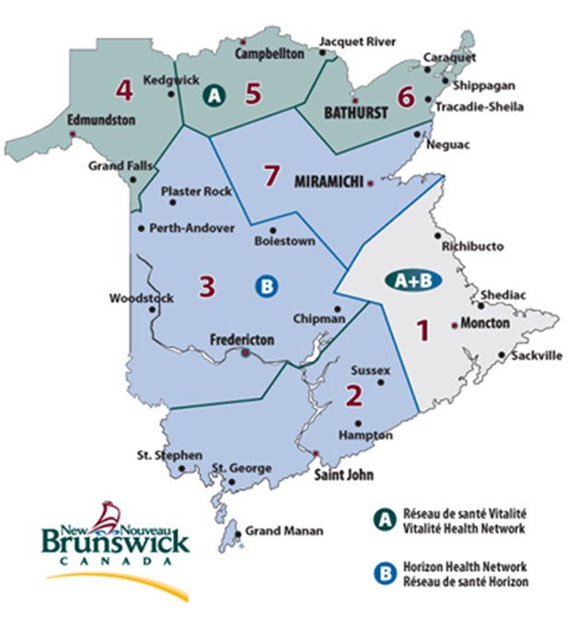
PHCACs in Horizon
From Left to Right…
Zone 2: Stephanie Neilson,
Zone 3: Nathanael Patriquin
Zone 1(B): Laurie Bouvier
Zone 7: Kerri Mullin

Slide 26
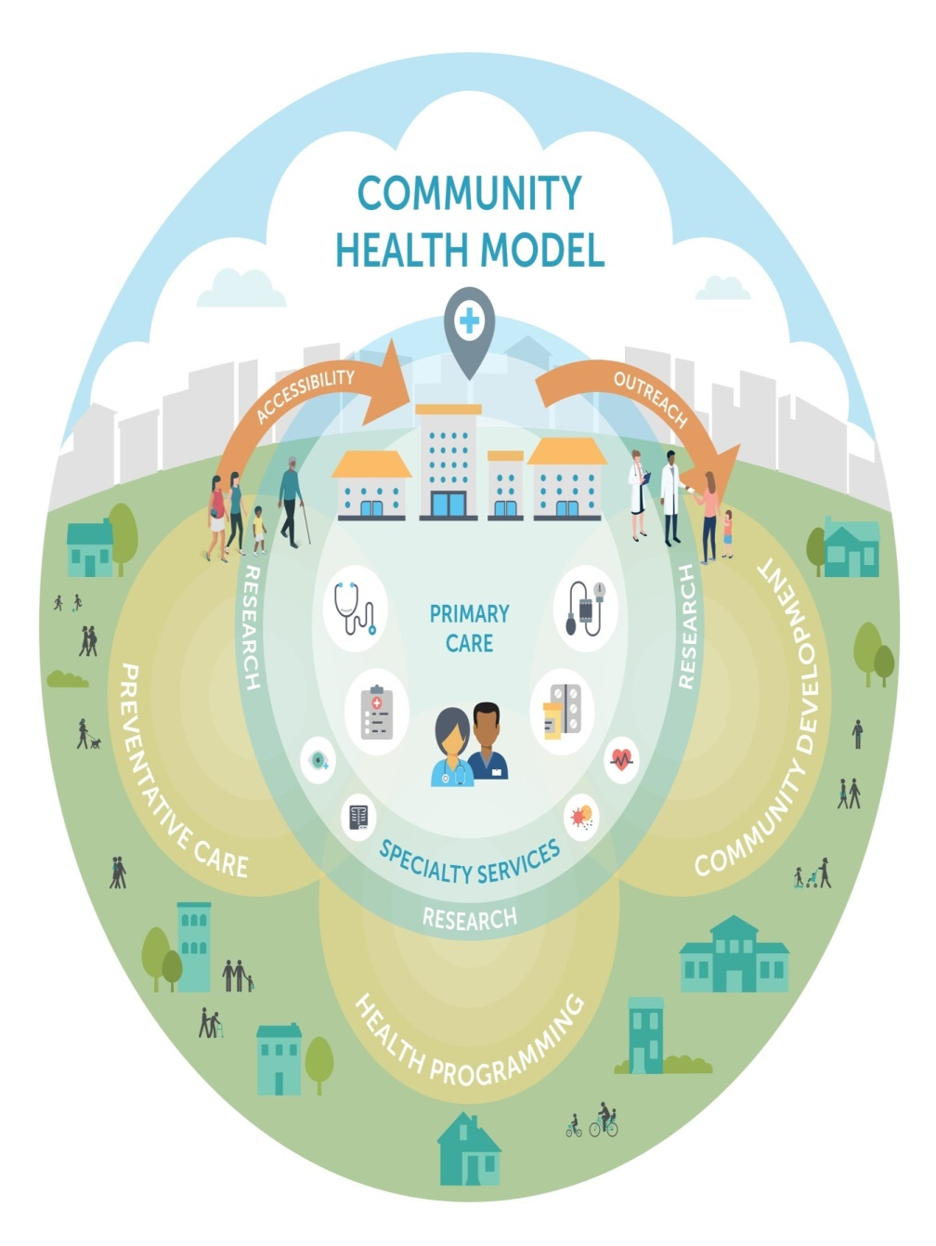

Slide 27
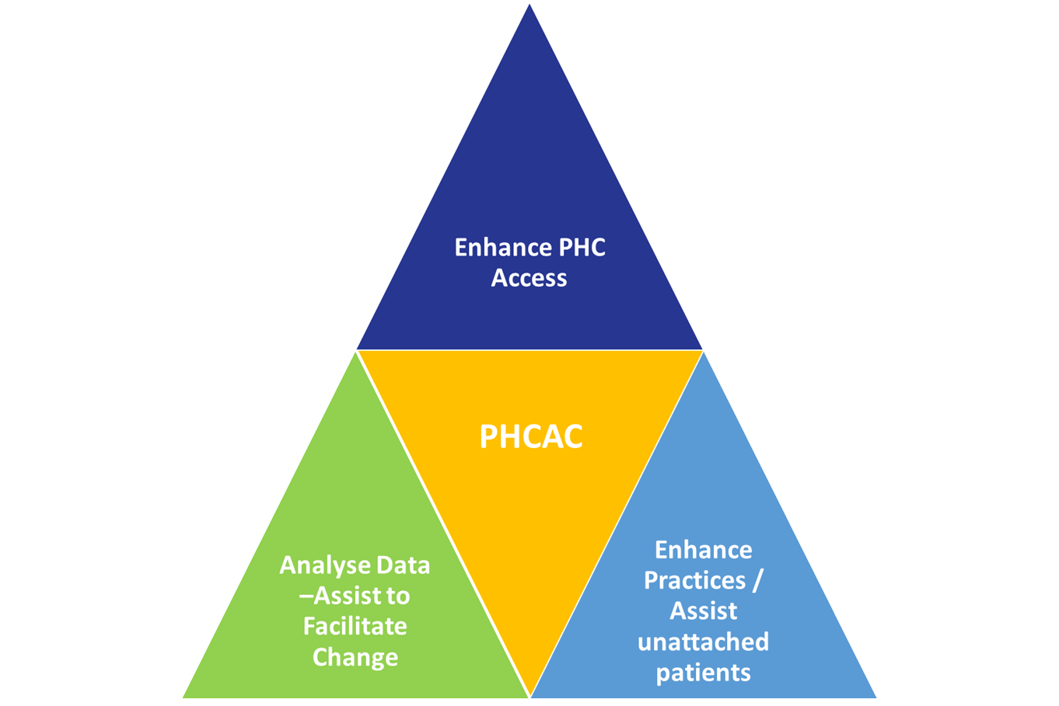

Slide 28
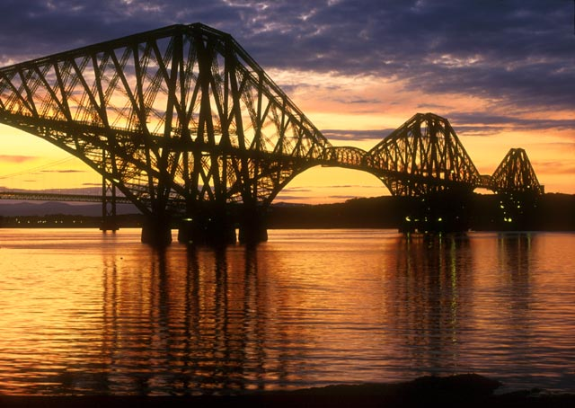
(ALLIED HEALTH EXAMPLE)

Slide 29


Helping to link families and individuals to Primary Care Providers (family physicians and nurse practitioners).

Slide 30
Santé publique
30 avril 2019

Slide 31


Sunny picture
Definition, monde plus sain

Slide 32


Slide 34
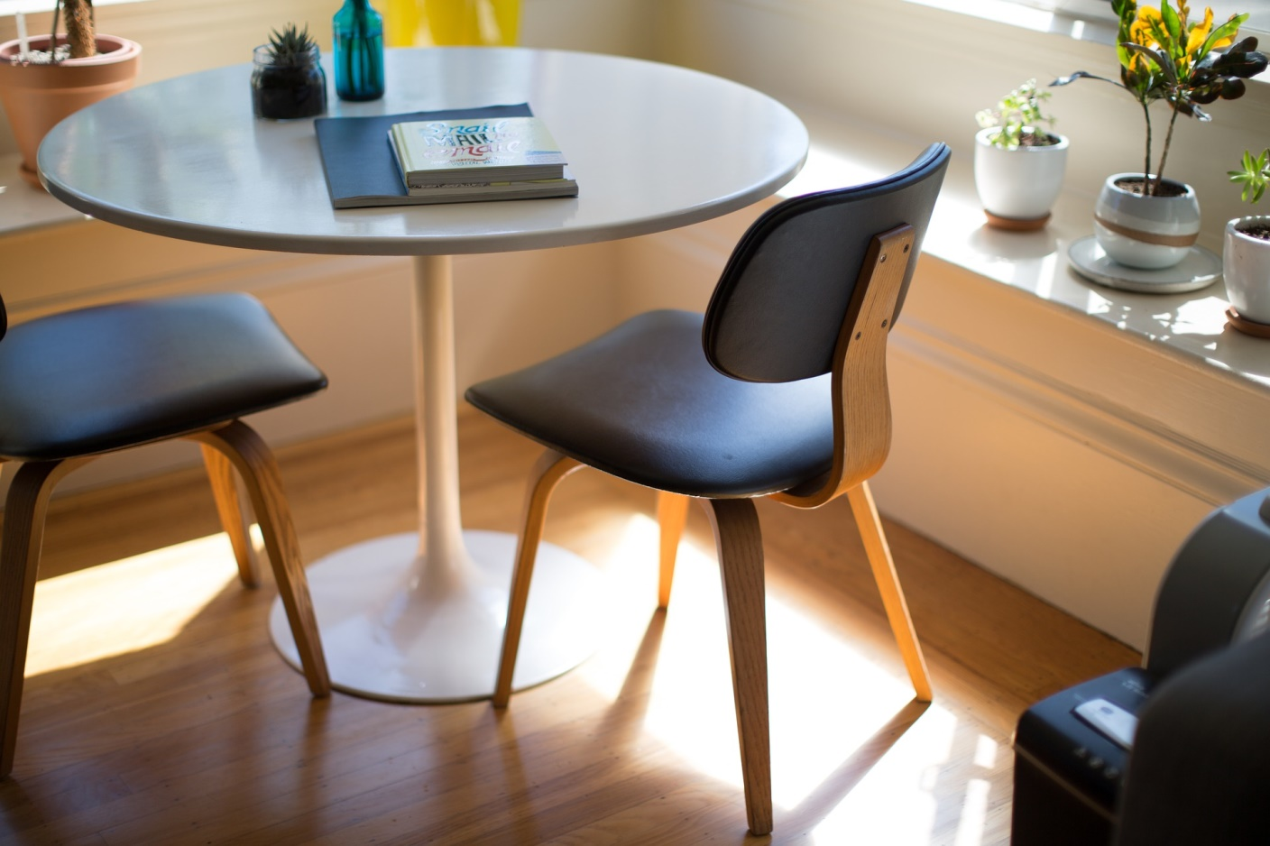

Slide 35


Slide 36


Slide 37

Notes:
Public Health’s programs and services focus on health promotion, prevention and protection from disease and injuries

Slide 38
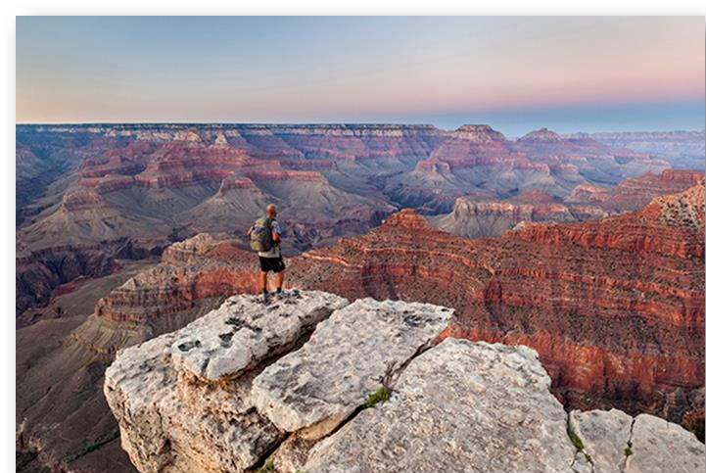
Notes:
Our work focuses on looking at the bigger picture or what is commonly known as a population health approach. This approach aims to improve the health of the entire population and to reduce health inequities among population groups.
The work of Public Health stands alone as it uniquely acknowledges health and what makes individuals/communities healthy. Health is not just the absence of disease; it is a capacity or resource for living that enables individual’s to grow, attain competencies/skills and education, and work towards goals while fulfilling personal hopes and desires. This unique comprehension and outlook of health presents the basis for population health work and its approach.

Slide 39
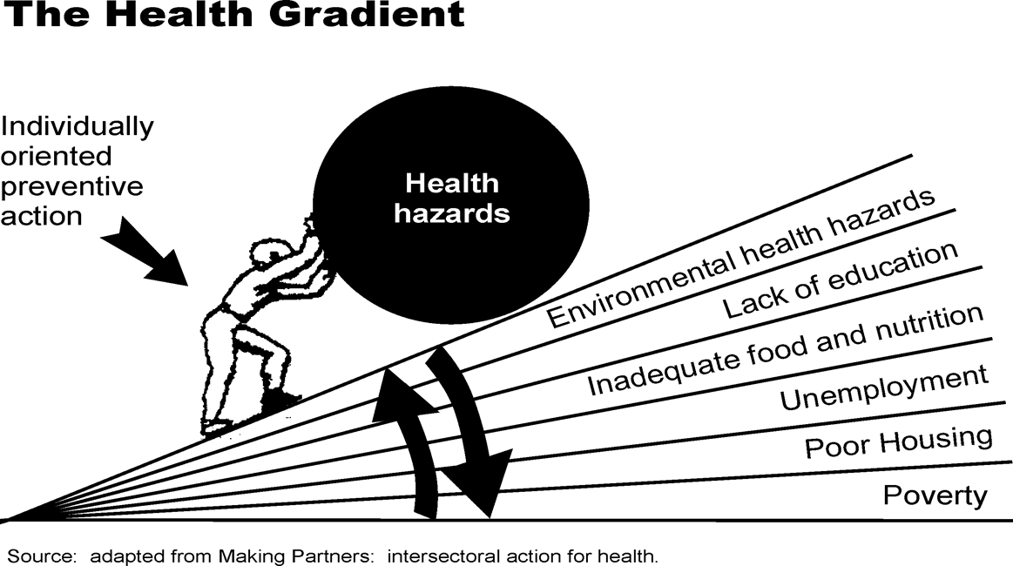
Notes:
In order to achieve this, Public Health looks at and acts upon a broad range of factors and conditions that have a strong influence on our health.

Slide 40
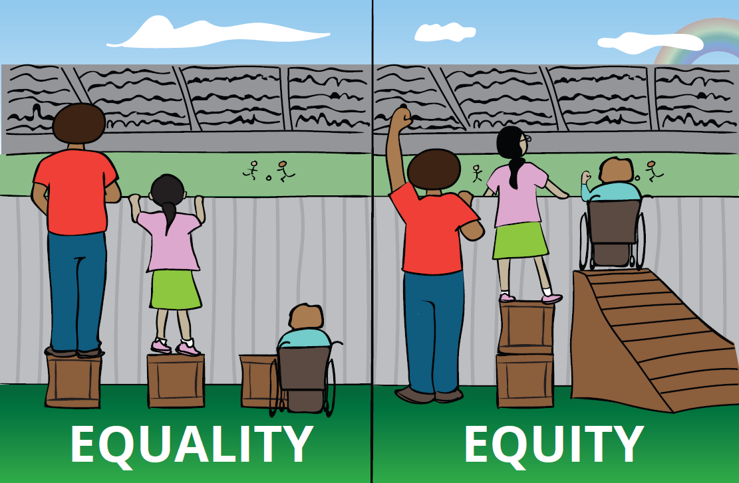
Notes:
We advocate for equity for all.
* Equality can be defined as treating each and every individual in the same manner irrespective of needs and requirements
Equity can be defined as the quality of treating individuals fairly based on their needs and requirements.

Slide 41
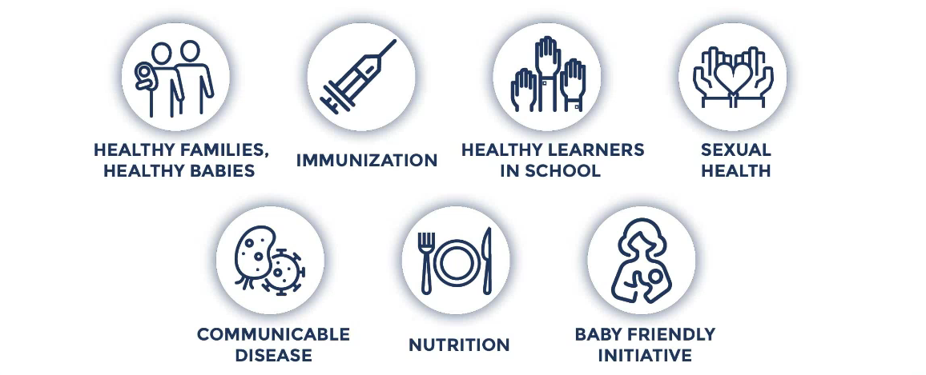
Notes:
In NB these are the Public Health programs that are offered. Let’s explore each one:

Slide 42
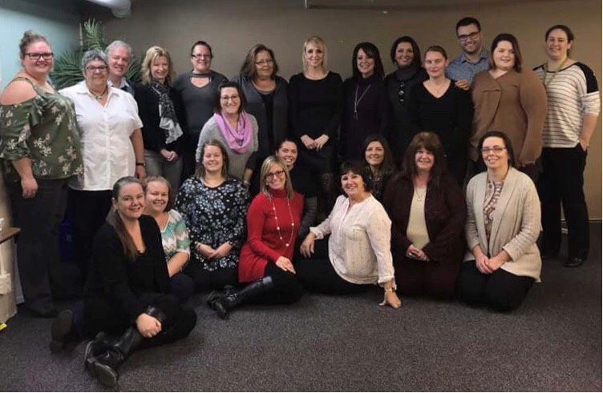
Canadian Mental Health Association of NB

Slide 43
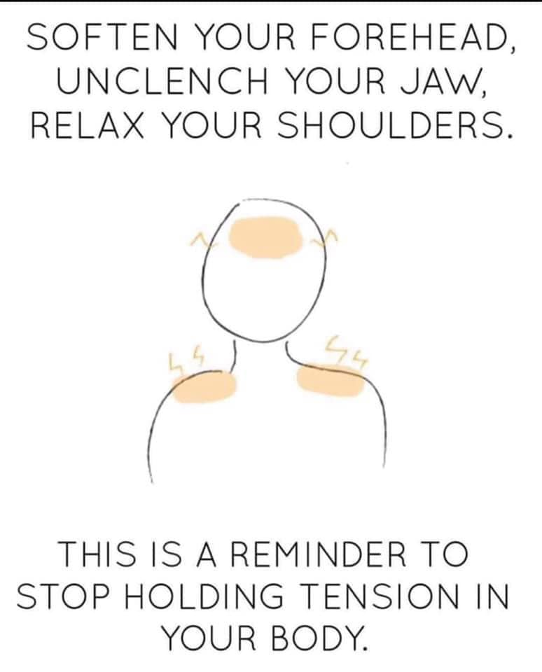

Slide 44
PROMOTE MENTAL HEALTH FOR ALL PEOPLE
CORE MH PROGRAMS AND PRESENTATIONS
PEER SUPPORT
EMPLOYMENT COUNSELLING
SELF HELP & SUPPORT GROUPS
WORKSHOPS
MH AWARENESS & WELLNESS EVENTS
ADVOCACY
PUBLIC POLICY

Slide 45
RANDOM NUMBERS!
5:5
70,000+
0-118
18
1,000,000

Slide 46
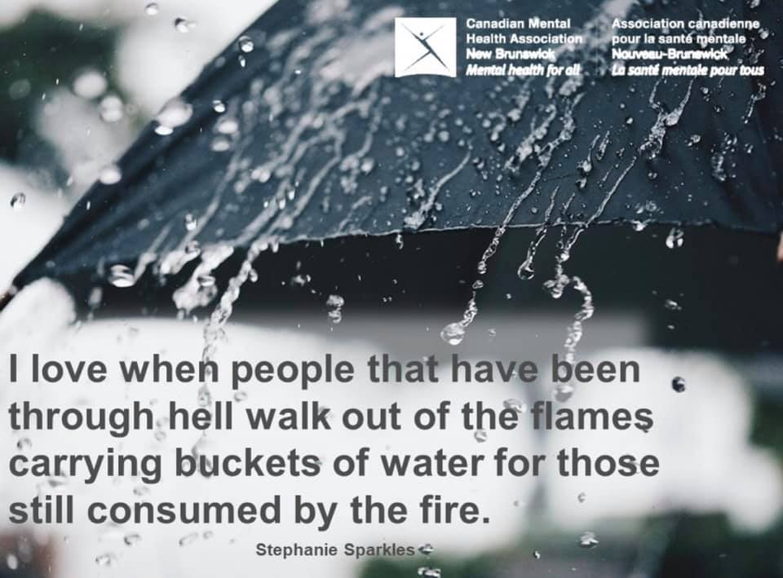

Slide 47
Sport and Recreation Branch
Ryan Jacobson
NEW BRUNSWICK TOURISM, HERITAGE AND CULTURE
A PROPOSAL BY Ryan Jacobson

Slide 48
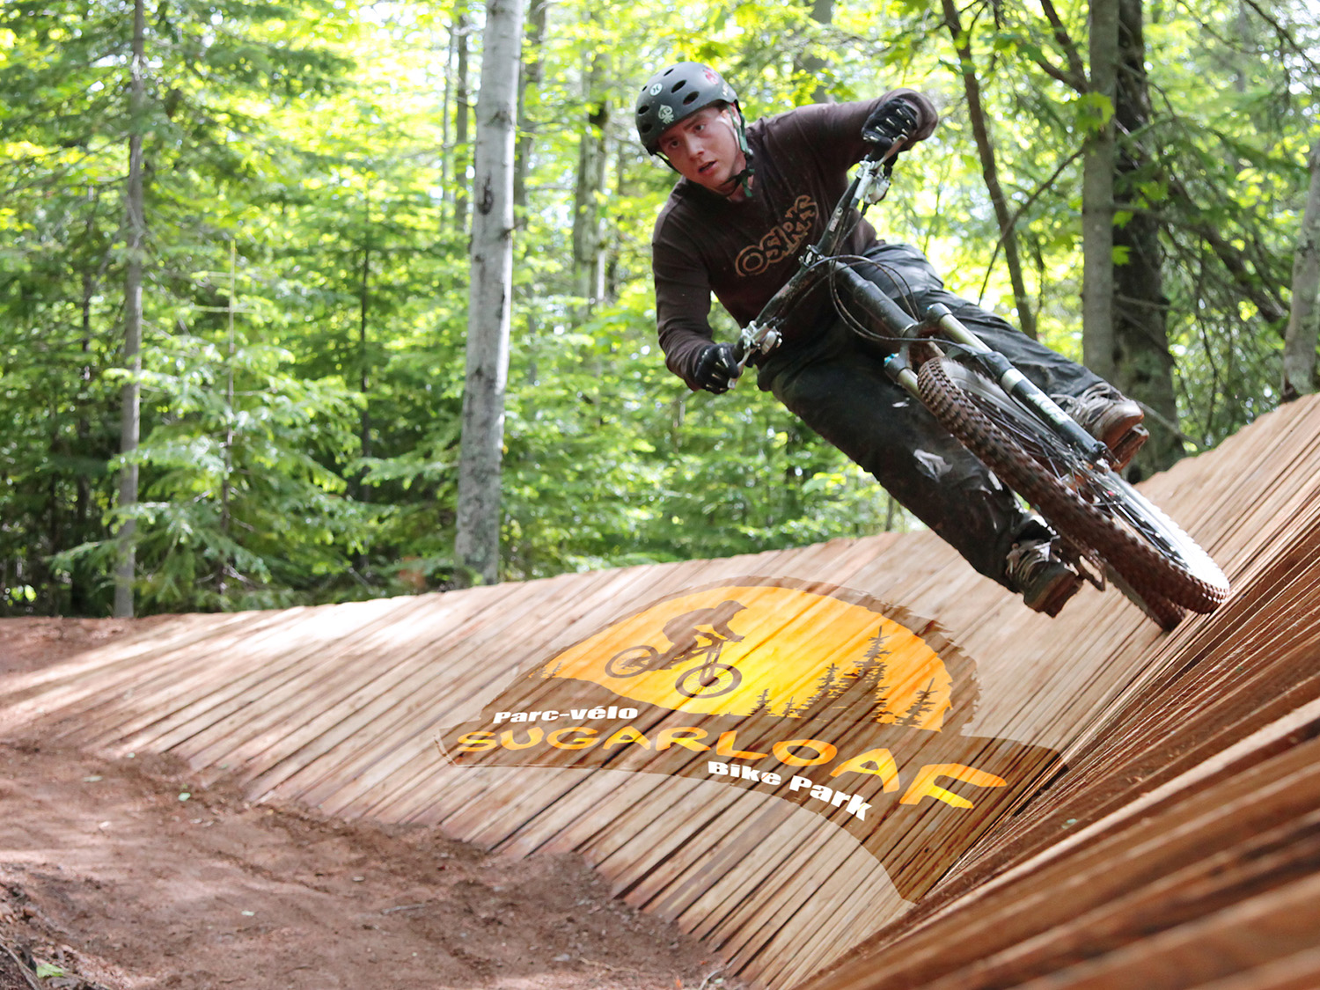

Sport and Recreation Branch
Mission: Provide strategic leadership and support to strengthen the sport and recreation system resulting in increased opportunities for active living to improve the wellbeing of all new Brunswickers
Vision: A strong and robust sport and recreation delivery system providing meaningful, accessible and highly valued opportunities that contribute to the wellbeing of all New Brunswickers
NEW BRUNSWICK TOURISM, HERITAGE AND CULTURE
A PROPOSAL BY Ryan Jacobson

Slide 49
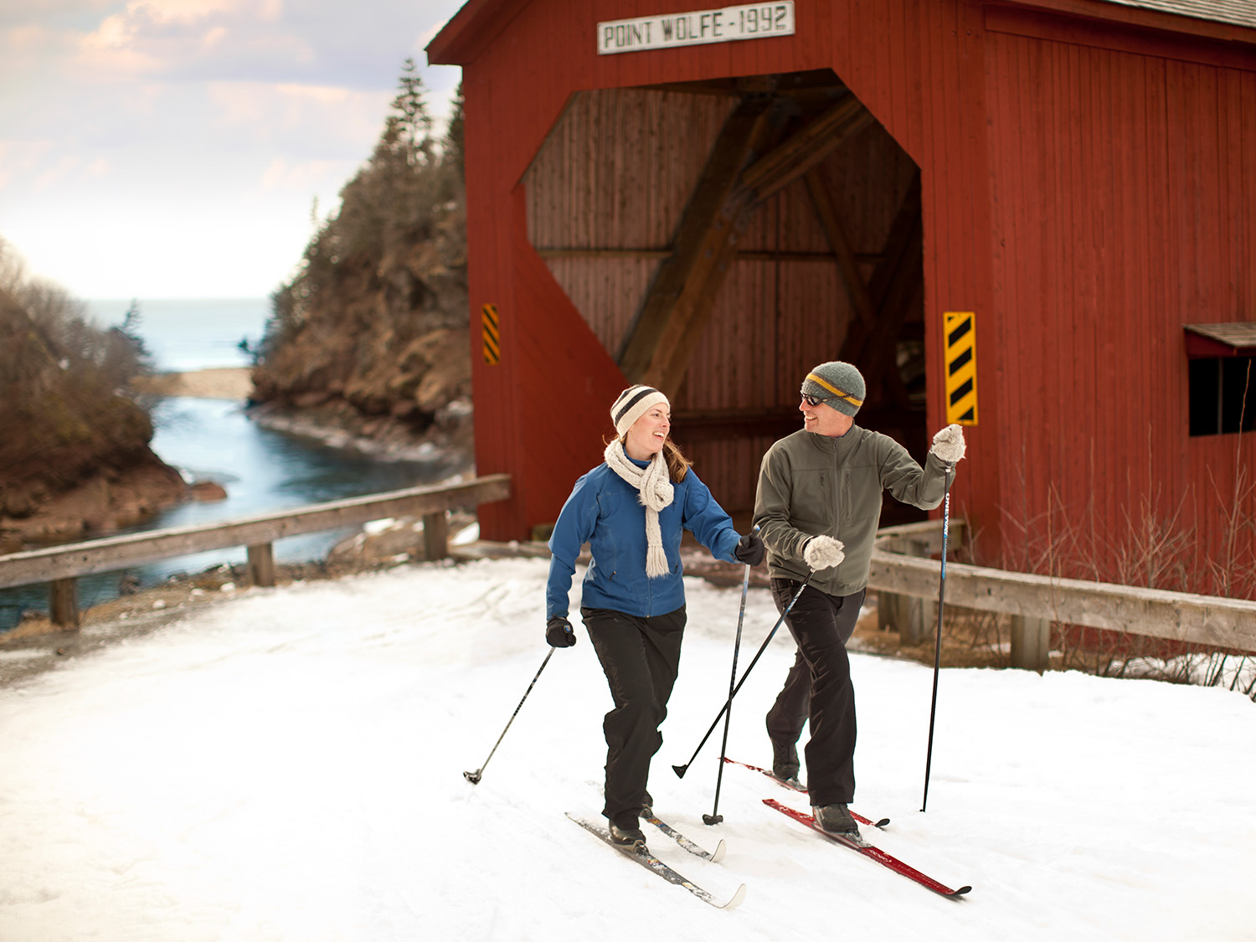
Sport and Recreation Branch
Strategic Goals
Active living
Inclusion and access
Supportive environments
Strengthening partnerships
Operational effectiveness
NEW BRUNSWICK TOURISM, HERITAGE AND CULTURE
A PROPOSAL BY Ryan Jacobson

Slide 50
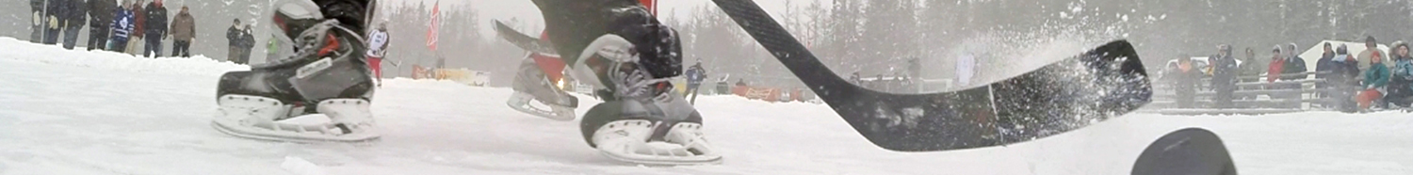
Our Partners
Eligible groups: not-for profits
Local sport and recreation groups
Municipalities
Regional Service Commissions
Non-motorized Trail Groups
Wellness Networks
Ineligible groups: for profit, educational institutions, motorized groups, GNB agencies
NEW BRUNSWICK TOURISM, HERITAGE AND CULTURE
A PROPOSAL BY Ryan Jacobson

Slide 51

Consultation Services
Organization development
  Constitution, bylaws, policies, strategic planning, board planning
Leadership development
  Coaches/leaders, officials, board members
Athlete development
  LTAD alignment, Athlete pathway
Fostering and promoting partnerships
Resource sharing
NEW BRUNSWICK TOURISM, HERITAGE AND CULTURE
A PROPOSAL BY Ryan Jacobson

Slide 52

Regional Funding Opportunities
Regional Grant Program
  Organization development
  Leadership development
  Long Term Athlete Development (LTAD)
  Games Hosting (multisport)
  Regional Profile Submission (multi-project grant)
  Active Communities Grant Program
  Go NB- Increase Youth Physical Literacy
  Trail Infrastructure Fund
NEW BRUNSWICK TOURISM, HERITAGE AND CULTURE
A PROPOSAL BY Ryan Jacobson

Slide 53
New Brunswick Health Council
Michelina Mancuso

Slide 54
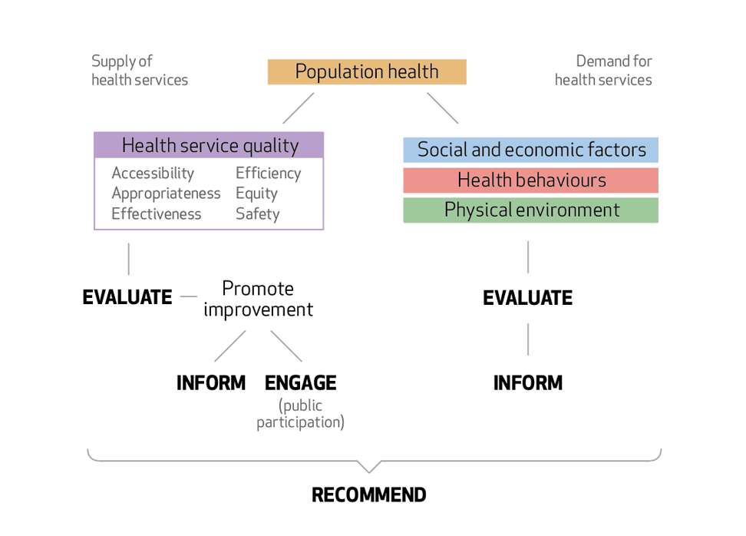
Notes:
Community Profiles are organized to support population health model (Health Reporting). Community data should support Regional Level Planning and priorities.

Slide 55

Notes:
Community Profiles are organized to support population health model (Health Reporting). Community data should support Regional Level Planning and priorities.

Slide 56
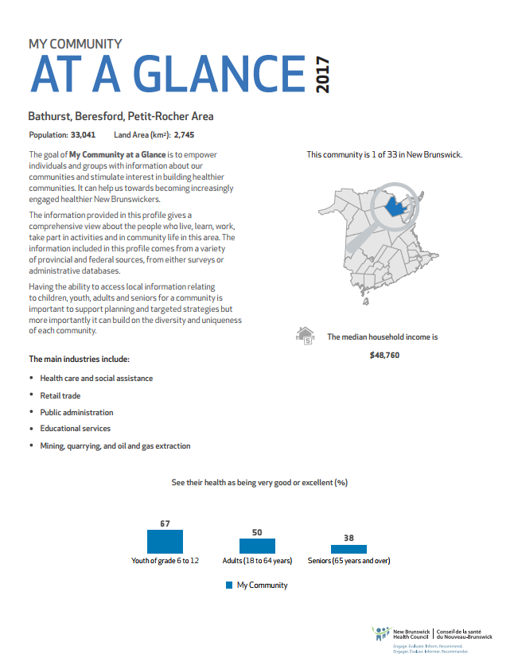
Community Profiles released June 2017
33 communities
~300 indicators (children / youth / adults / seniors)
Information (30 Sources)
  Contextual
  Determinants of health
  Health outcomes
  (3 year cycle)
www.nbhc.ca/community-profiles
Notes:
Indicator choice:
Follow the NBHC Population Health Model (or help provide the contextual information about the community)
Reliable data and source
Reproducible information
Availability at the community level (when possible)

Slide 57

Questions?
Michelina Mancuso
Directrice exécutive de l’évaluation du rendement
Executive Director of Performance Measurement
Michelina.Mancuso@csnb.ca
Michelina.mancuso@nbhc.ca
1.877.225.2521
www.csnb.ca
www.nbhc.ca

Slide 58


Wellness Branch
Social Development
Notes:
We are small but mighty 13.6 Provincial Staff
8 Regional Staff (1 per region)
2 School Wellness Consultants
A mix of backgrounds and expertise Take lead in content areas, initiatives, settings or populations
A mix of backgrounds and expertise in community development

Slide 59

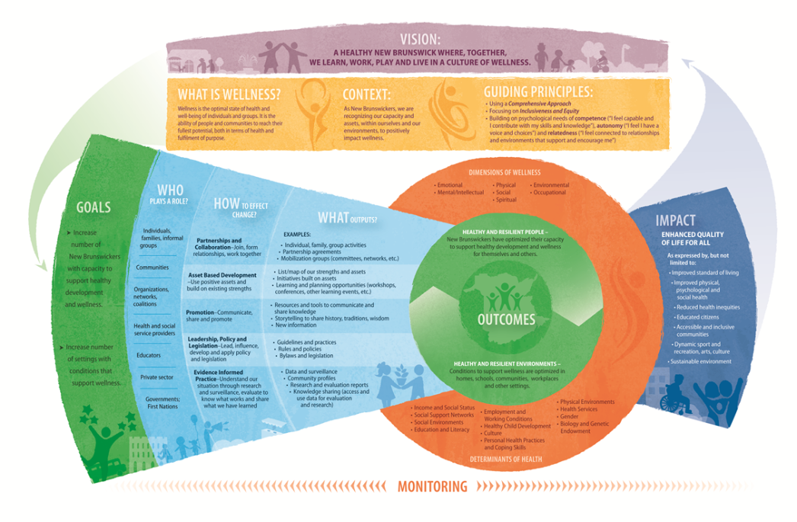

Partnership and Collaboration –
Join, form relationships, work together
Asset Based Development –
Use positive assets and build on existing strengths
Promotion –
Communicate, share and promote
Leadership, Policy and Legislation –
Lead, influence, develop and apply policy and legislation
Evidence Informed Practice –
Understand our situation through research and surveillance, evaluate to know what works and share what we have learned
Notes:
Provincial and regional Wellness Consultants are guided in their work by NB’s Wellness Strategy together we are responsible for taking a leadership role in implementing the wellness strategy.
Regional Wellness Consultants connect community partners to the Strategy or connect the Strategy to their community partners work via Wellness Networks, community Partnerships
Provincial consultants are more focused while regional consultant are broader in their scope

Slide 60
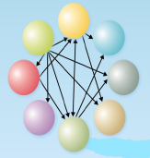
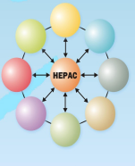
Asset Based Community Development
Wellness Networks
From this
To this
Wellness
Network
Notes:
Regional Wellness Consultants connect community partners to the Strategy or connect the Strategy to their community partners work via Wellness Networks, community Partnerships
Provincial consultants are more focused while regional consultant are broader in their scope

Slide 61
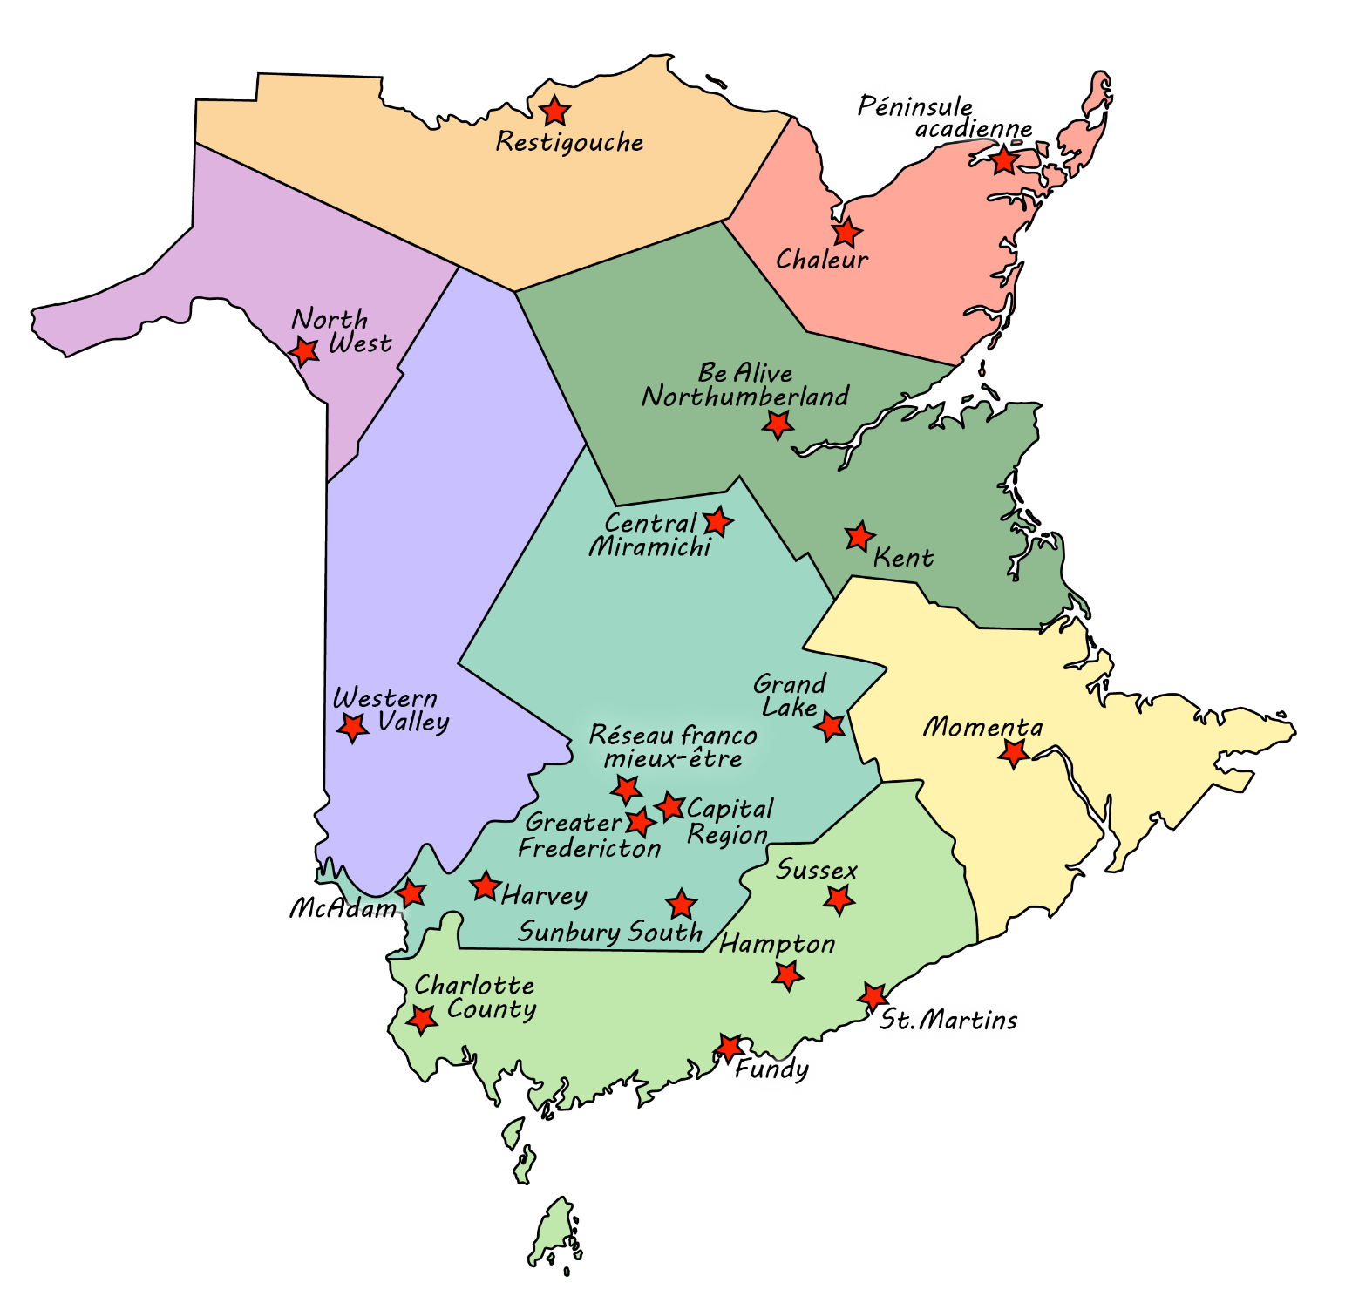
Wellness Regions & Networks
Notes:
The wellness branch divides the province into 8 regions. There is 1 regional wellness consultant responsible for each region
There are currently many Wellness Networks. Some regions have more than one Network depending on the demographics and the needs of their region.
In general, most Wellness Networks are comprised of a Steering Committee and sub-committees or working groups in key areas,
The approach is all about participation, contribution and communication.
Wellness Networks determine autonomously their key areas of focus based on the Forum. that these areas of focus are also informed by data - the Community Profiles prepared by the NBHC

Slide 62
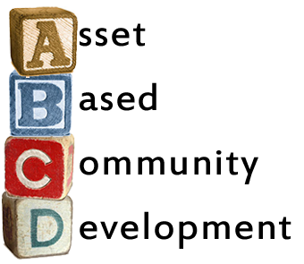

Asset Based Community Development
Notes:
Using asset based approach to create Supportive environments - Branch’s work is focused in 4 areas (Physical Activity, Healthy Eating, Mental Fitness & Tobacco Free Living) in 4 settings (Homes, schools, communities and workplaces). Then add that the Regional Wellness Consultants currently have 3 priority areas – Mental Fitness and Resilience, Food Security and Healthy Aging.
Support development and ongoing efforts of Wellness Networks and their community engagement initiatives
Network and build partnerships
Support provincial Wellness programs and initiatives
Champion The Wellness Movement to support community promotion efforts
Provide professional expertise

